Slide 1

Video Game's Review
CSE – 111 Database Systems
By Guillermo Zarate and Donovan Malloy

Slide 2

System Description
Our project is an app to search up information for video games on different platforms.
- Users can see what platform the game is on
- The overall reviews on that game
- The game sales in different regions
Search up information on the developers as well.
- Where they are based at
- The notable games they have
See the completion rate of different games.

Slide 3

Use-Case Diagram
Company
Developer
Search/Filter
Indie
Developer
Game Data
Includes
Extend
PS4 Game Sales
View only
Modify Data
Game Sales
Windows Game
Sales
Admin
User
Extend
Xbox1Game Sales
Game Completion

Slide 4
E/R Diagram
PS4 Games
Scores
Critics
Sales
Xbox1 Games
Has
Name
Players
Game
Data
Genre
Release Year
Users
Name
Country
User Scores
Extends
Video Game Title
Name
Developed By
Video Game
Developer
City
Windows Games
Has
Platform
Completion Rate
Developed By
Country
Main
Story
Main / Extras
Completion
Name
Indie Game
Developer
City
Completionist
Coop
Versus
Name

Slide 5
Schema
Video_Games_Developers
developers city administrative_division country est notable_games notes
Xbox1_GamesSales
games year genre publisher north_america europe japan rest_of_world global
Windows_Games
titles released developers publishers genres
Video_Games_Sales
name platform Year_of_release genre publisher na_sales eu_sales jp_sales other_sales global_sales
Games_Data
name platform r-date score user_score developer genre players critics users
Games_Completion
id title main_story main_plus_extras completionist all_styles coop versus type developers
Indie_Games_Developers
developers city administrative_area country notable_games notes
PS4_GamesSales
games year genre publisher north_america europe japan rest_of_world global

Slide 6
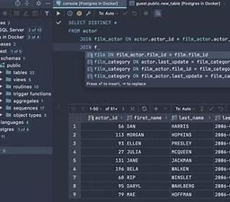
Implementation Details
The IDE that we will be using is Visual Studio Code
The language platform will be Python

